Slide 1
Using iocbuilder
Ronaldo Mercado
Beamline Controls
EPICS Oxfordshire Meeting
CLF, 24 May 2017

Slide 2
Overview
Introduction
Description
Pointers and documentation
Scripted ioc generation
Xml ioc generation
Why use the IOC builder?
Look under the hood
Conclusions

Slide 3
Introduction
Authors are Michael Abbot and Tom Cobb since around 2006
Iocbuilder module definitions “builder.py” maintained by many
Originally used for diagnostics in scripted form
Use in beamlines using xml builder (*)
Used for power supplies and girder movers
(*) Along with two competing methods: spreadsheets and substitution files

Slide 4
Original motivation: a set of classes for generating .db files from Python
Python Script
IOC builder
.db file
A version of this was published as “epics db builder” (github) https://github.com/Araneidae/epicsdbbuilder

Slide 5
Extending to building entire IOC
An IOC consists of many components, much of it either boilerplate or else module specific:
Makefiles
configure/RELEASE, for module versions
Template substitutions: can be very repetitive
Startup scripts, again often repetitive, and encapsulate a lot of module specific knowledge

Slide 6
IOC Builder building an IOC
Build Script
XML
definitions
or
+
Complete IOC:
complete IOC directory
configure/RELEASE, reflecting version info
template substitutions
generated .db files
startup scripts
Just run make and it's ready to run.
Version
info
IOC builder
Module Specific
Definitions

Slide 7
Module Specific Definitions
Builder definition files contain build information for that module
They live in the file
<module>/etc/builder.py
The file is loaded by the builder and becomes available as
iocbuilder.modules.<module>
They typically contain AutoSubstitution or Device subclasses that are instantiated to create an IOC

Slide 8
Pointers and documentation
Diamond controls downloads
http://controls.diamond.ac.uk/downloads/python/iocbuilder/
ICALEPCS 2011 paper “An EPICS IOC builder” (abstract) (pdf)
Github sources https://github.com/Araneidae/iocbuilder

Slide 9
Scripted IOC build (demo if possible)
Hardware definitions are more involved. This is a simplified fragment of an example builder definition file:
from pkg_resources import require
require("iocbuilder==3.54")
import iocbuilder
iocbuilder.ConfigureIOC(architecture = 'linux-x86_64')
from iocbuilder import *
ModuleVersion('asyn', '4-26')
….
ModuleVersion('ADCore', '2-4dls8')
ModuleVersion('ADPilatus', '2-1dls13')
ioc = modules.devIocStats.devIocStatsHelper(ioc='RJ01Q-CS-IOC-16', name = 'IOCS.CS16')
det = modules.ADPilatus.pilatusDetector(PORT="SAXS.PIL.CAM",
CAMSERVER="10.10.10.100:41234", XSIZE=1475, YSIZE=1679,
BUFFERS=100, CBF_TRANSFER=0, CAMSERVER_HOST="10.10.10.100",
TIMEOUT="1", CBF_TEMPLATE_LOCATION="/tmp/cbf_templates",
ADDR=0, P=“RJ01Q-EA-PILAT-01", R=":CAM:")
WriteNamedIoc('/tmp/a3', 'TEST-IOC', edm_screen = True)

Slide 10
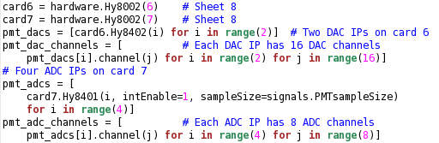
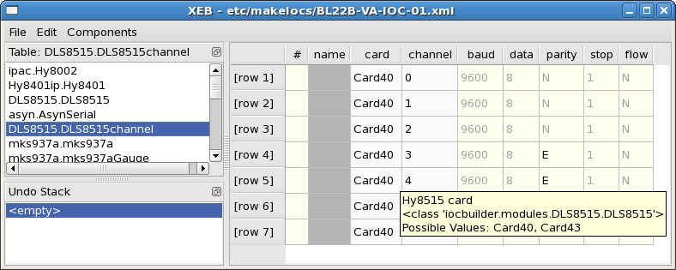
Xmlbuilder – What is it? Demo if possible too

Slide 11
Why use the IOC Builder?
A simple IOC is just a set of component instances.
For beamlines an XML file specifies components and parameters.
Component definitions are created for modules – many examples to look at – from simple templates to hardware.
Hardware component definitions encapsulate application specific knowledge
iocbuilder gives a more concise and friendlier description of an ioc.

Slide 12
Look under the hood
DLS specific dependencies
“paths.py”
dls_dependency_tree (for xmlbuilder)
http://controls.diamond.ac.uk/downloads/python/dependency_tree/
EDM screen generation
dls_edm

Slide 13
Python loading paths (1/2)
1 python iocbuilder module
from pkg_resources import require require(“iocbuilder==3.54”) from iocbuilder import Device
Loads from /dls_sw/prod/common/python/RHEL6-x86_64/iocbuilder/3-54/iocbuilder
2 iocbuilder dependencies
from iocbuilder.arginfo import *
Loads from /dls_sw/prod/common/python/RHEL6-x86_64/iocbuilder/3-54/iocbuilder/arginfo.py

Slide 14
Python loading paths (2/2)
3 epics support module dependencies
from iocbuilder.modules.asyn import Asyn, AsynPort
Loads from builder.py in the asyn module as configured with ModuleVersion
e.g /dls_sw/prod/R3.14.12.3/support/asyn/4-26/etc/builder.py

Slide 15
Conclusion
Concise description of ioc setup
Encapsulation of application specific knowledge
Many users at Diamond!

Slide 16
Thank you for the interest

